Slide 1
Accessibility Testing with Screen Readers & More
Erissa Duvall

Slide 2


Agenda
Quick Intro
What are we testing for?
Automated v Manual
Bookmarklets
Browser Extensions
Screen Readers
Resources
start

Slide 3

Disclaimer
I have gotten A LOT of experience from my professional roles, but I am not officially representing my current and/or former employers.
I discuss regulations and legal standards, but I am not in any way a lawyer, solicitor, or someone otherwise trained/licensed to give legal advice.
start

Slide 4
Accessibility & Disability
Quick Summary
start

Slide 5
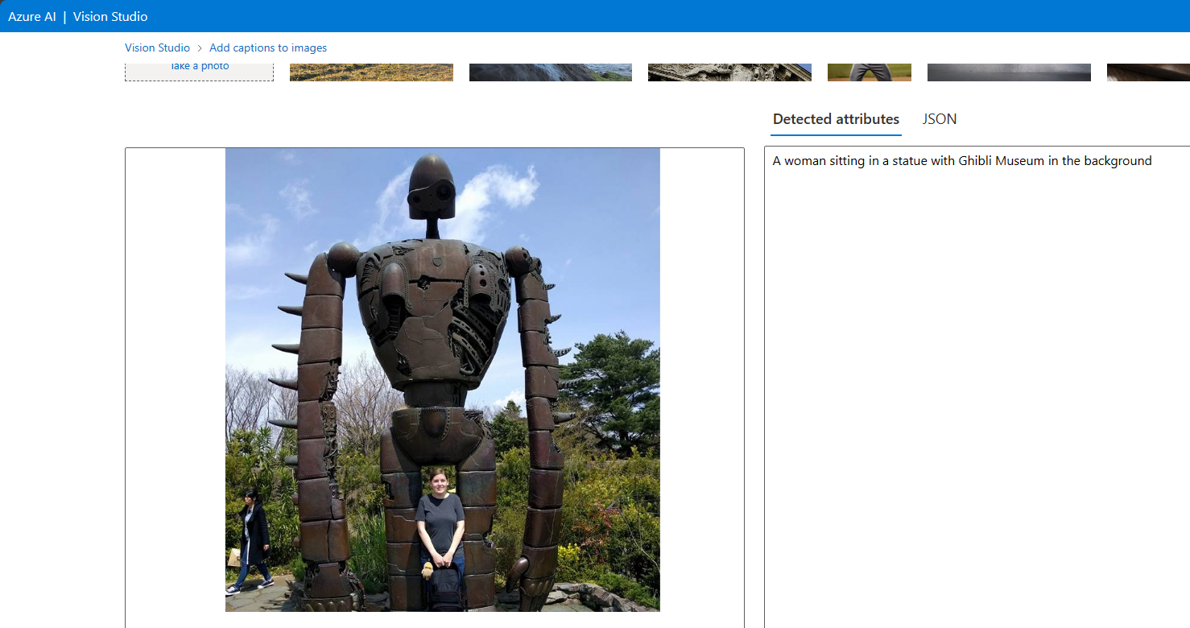
What are we testing & why not just automate?
Accuracy
Intent
Structure
Relationships
Custom Content
start
Notes:
Azure Vision Studio - https://portal.vision.cognitive.azure.com/demo/image-captioning
Image of a dog next to a sign saying they beat cancer was found: https://images.foxtv.com/static.foxla.com/www.foxla.com/content/uploads/2023/05/1280/720/dog-beats-cancer-fox-news.jpg?ve=1&tl=1

Slide 6
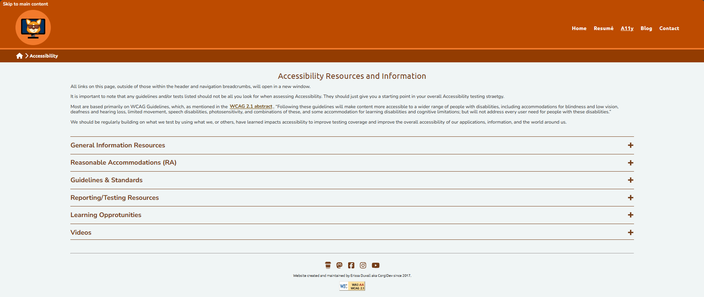
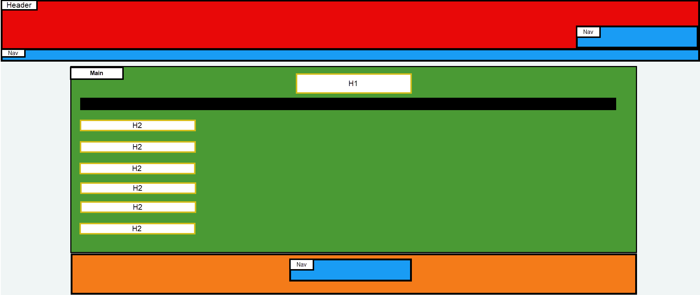
What are we testing & why not just automate?
start
Notes:
Azure Vision Studio - https://portal.vision.cognitive.azure.com/demo/image-captioning
Image of a dog next to a sign saying they beat cancer was found https://dailyboxer.com/boxer-health/i-beat-cancer-naturally-daisys-story/.

Slide 7
Testing Combinations
Operating System | MacOS | Windows | iOS | Android | Linux
Platforms | Desktop | Desktop | Mobile | Mobile | Desktop
Browsers | Safari Chrome Firefox | Edge Chrome Firefox | Safari Chrome Firefox Edge | Chrome Firefox Edge | Chrome Firefox Edge
Screen Readers | VoiceOver | JAWS NVDA Narrator Dolphin | VoiceOver | TalkBack | Orca
start

Slide 8
Known Compatibility Issues
Android | TalkBack doesn’t always read required attributes even when you use aria-required.
MacOS & iOS | When using VoiceOver & Safari, unordered lists that have had their styling removed won’t be read as lists consistently.
Windows | Safari Chrome Firefox
start

Slide 9
Areas of growth
 | B2B | Supply chain | ROI | E-commerce
Q1 | 4.5 | 2.3 | 1.7 | 5.0
Q2 | 3.2 | 5.1 | 4.4 | 3.0
Q3 | 2.1 | 1.7 | 2.5 | 2.8
Q4 | 4.5 | 2.2 | 1.7 | 7.0
start

Slide 10
Business opportunities are like buses. There's always another one coming.
Richard Branson
start

Slide 11




Meet our team
Takuma Hayashi​
Mirjam Nilsson​
Flora Berggren​
Rajesh Santoshi​
President
Chief Executive Officer
Chief Operations Officer
VP Marketing
start

Slide 12




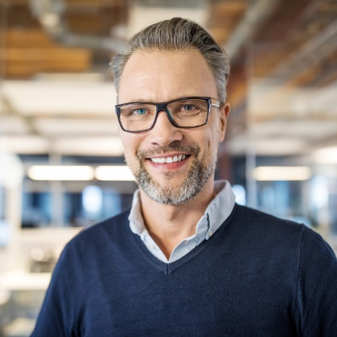



Meet our extended team
Takuma Hayashi
Mirjam Nilsson​
Flora Berggren​
Rajesh Santoshi​
President
Chief Executive Officer
Chief Operations Officer
VP Marketing
Graham Barnes
Rowan Murphy
Elizabeth Moore
Robin Kline
VP Product
SEO Strategist
Product Designer
Content Developer
start

Slide 13
Plan for product launch
Planning
Marketing
Design
Strategy
Launch
Synergize scalable e-commerce
Disseminate standardized metrics
Coordinate e-business applications
Foster holistically superior methodologies
Deploy strategic networks with compelling e-business needs
start

Slide 14
Timeline
Deploy strategic networks with compelling e-business needs
Sep 20XX
Synergize scalable e-commerce
Nov 20XX
Disseminate standardized metrics
Jan 20XX
Coordinate e-business applications
Mar 20XX
Foster holistically superior methodologies
May 20XX
start

Slide 15
Areas of focus
B2B market scenarios
Cloud-based opportunities
Develop winning strategies to keep ahead of the competition
Capitalize on low hanging fruit to identify a ballpark value
Visualize customer directed convergence
Iterative approaches to corporate strategy
Establish a management framework from the inside
start

Slide 16
How we get there
Niche markets
Pursue scalable customer service through sustainable strategies
Engage top-line web services with cutting-edge deliverables
ROI
Supply chains
Envision multimedia-based expertise and cross-media growth strategies
Engage worldwide methodologies with web-enabled technologies
Cultivate one-to-one customer service with robust ideas
Maximize timely deliverables for real-time schemas
start

Slide 17

Summary
At Contoso, we believe in giving 110%. By using our next-generation data architecture, we help organizations virtually manage agile workflows. We thrive because of our market knowledge and great team behind our product.
As our CEO says, "Efficiencies will come from proactively transforming how we do business."
start

Slide 18
Thank you
Mirjam Nilsson​
mirjam@contoso.com
www.contoso.com
start

